Slide 1
YOLO (You look only once)
Algorithm

Slide 2
Basics of yolo algorithm
YOLO is an abbreviation for the term 'You Only Look Once'.
This is an algorithm that detects and recognizes various objects in a picture (in real-time)

Slide 3
Why to use Yolo algorithm
High accuracy: YOLO is a predictive technique that provides accurate results with minimal background errors.
Speed: This algorithm improves the speed of detection because it can predict objects in real-time.
Learning capabilities: The algorithm has excellent learning capabilities that enable it to learn the representations of objects and apply them in object detection.

Slide 4
How does YOLO algorithm works.
YOLO algorithm works using the following three techniques:
Residual blocks
Bounding box regression
Intersection Over Union (IOU)

Slide 5
Implementation of yolo algorithm using open cv
OpenCV-Python is a library of Python bindings designed to solve computer vision problems.
The libraries used in this algorithm are.
import numpy as np
import cv2
import matplotlib.pyplot as plt
import time

Slide 6
Datasets needed for implementation
Coco names ( dataset for names of objects.)
Weight paths (weight for the classification objects.)
Configuration path (dataset for configuration)
Images for trial ( testing images.)

Slide 7
Model for training.
OpenCV's DNN module
This module lets you use pre trained neural networks from popular frameworks like tensorflow, pytorch etc and use those models directly in OpenCV. This means you can train models using a popular framework like Tensorflow and then do inference/prediction with just OpenCV

Slide 8
YOLO algorithm implementation.
labels = open('../input/yolo-coco-data/coco.names').read().strip().split('\n') # list of names
# paths for weight and configuration
weights_path = '../input/yolo-coco-data/yolov3.weights'
config_path = '../input/yolo-coco-data/yolov3.cfg'
# Setting minimum probability to eliminate weak predictions
min_prob = 0.5
# Setting threshold for non maximum suppression
threshold = 0.3

Slide 9
YOLO algorithm implementation.
model = cv2.dnn.readNetFromDarknet(config_path, weights_path)
# Getting names of all layers
layers_names = model.getLayerNames()
# Getting only output layers' names that we need from YOLO algorithm
output_layers = [layers_names[i[0] - 1] for i in model.getUnconnectedOutLayers()] # list of layers' names
image_input = cv2.imread('../input/test-images/download (1).jpg')
# Getting image shape
image_input_shape = image_input.shape
blob = cv2.dnn.blobFromImage(image_input, 1 / 255.0, (416, 416), swapRB=True, crop=False)
blob_to_show = blob[0, :, :, :].transpose(1, 2, 0)

Slide 10
YOLO algorithm implementation.
np.random.seed(42)
# randint(low, high=None, size=None, dtype='l')
colours = np.random.randint(0, 255, size=(len(labels), 3), dtype='uint8')
# Preparing lists for detected bounding boxes, obtained confidences and class's number
bounding_boxes = []
confidences = []
class_numbers = []
# Getting spacial dimension of input image
h, w = image_input_shape[:2]

Slide 11
for result in model_output:
# Going through all detections from current output layer
for detection in result:
# Getting class for current object
scores = detection[5:]
class_current = np.argmax(scores)
# Getting confidence (probability) for current object
confidence_current = scores[class_current]
# Eliminating weak predictions by minimum probability
if confidence_current > min_prob:
box_current = detection[0:4] * np.array([w, h, w, h])
# From current box with YOLO format getting top left corner coordinates
x_center, y_center, box_width, box_height = box_current.astype('int')
x_min = int(x_center - (box_width / 2))
y_min = int(y_center - (box_height / 2))
# Adding results into prepared lists
bounding_boxes.append([x_min, y_min, int(box_width), int(box_height)])
confidences.append(float(confidence_current))
class_numbers.append(class_current)

Slide 12
# implementing non maximum supppppression of boxes and correspoding scores
results = cv2.dnn.NMSBoxes(bounding_boxes, confidences, min_prob, threshold)
# Saving found labels
with open('found_labels.txt', 'w') as f:
for i in range(len(class_numbers)):
f.write(labels[int(class_numbers[i])])

Slide 13
# check weather any object detected or not
if len(results) > 0:
# Going through indexes of results
for i in results.flatten():
# Getting current bounding box coordinates
x_min, y_min = bounding_boxes[i][0], bounding_boxes[i][1]
box_width, box_height = bounding_boxes[i][2], bounding_boxes[i][3]
# Preparing colour for current bounding box
colour_box_current = [int(j) for j in colours[class_numbers[i]]]
# Drawing bounding box on the original image
cv2.rectangle(image_input, (x_min, y_min), (x_min + box_width, y_min + box_height),
colour_box_current, 5)
# Preparing text with label and confidence for current bounding box
text_box_current = '{}: {:.4f}'.format(labels[int(class_numbers[i])], confidences[i])
# Putting text with label and confidence on the original image
cv2.putText(image_input, text_box_current, (x_min, y_min - 7), cv2.FONT_HERSHEY_SIMPLEX,
1.5, colour_box_current, 5)

Slide 14
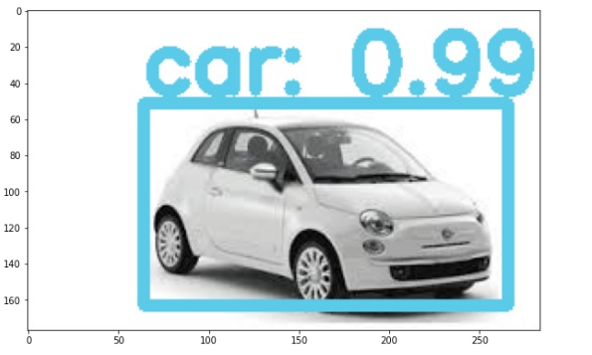
YOLO algorithm Output.
# showing image with detected objects
%matplotlib inline
plt.rcParams['figure.figsize'] = (10.0, 10.0)
plt.imshow(cv2.cvtColor(image_input, cv2.COLOR_BGR2RGB))
plt.show()

